Slide 1


Smart Apply 📋
AI Agents Hackathon Submission
AI Agents

Slide 2



About the Team!

Slide 3




Our Project
Smart Apply uses LLM AI Agents and Web Scraping to simplify the process of crafting personalized resumes tailored to individual skills, experiences, and career goals!
We utilized:
Langchain
CAMEL AGI

Slide 4
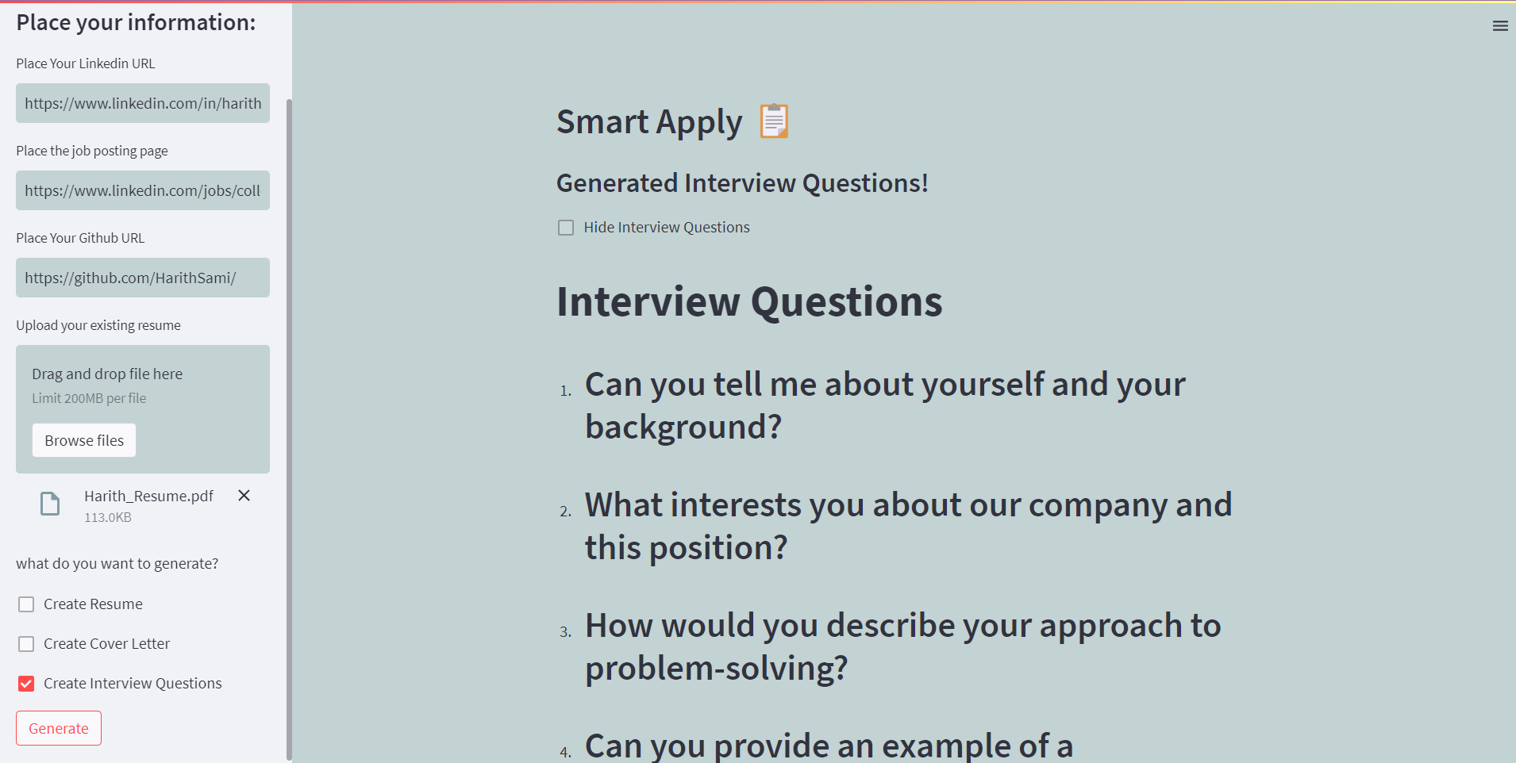

Slide 5

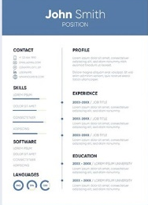

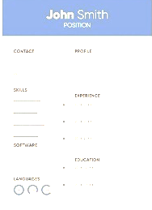
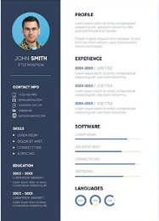
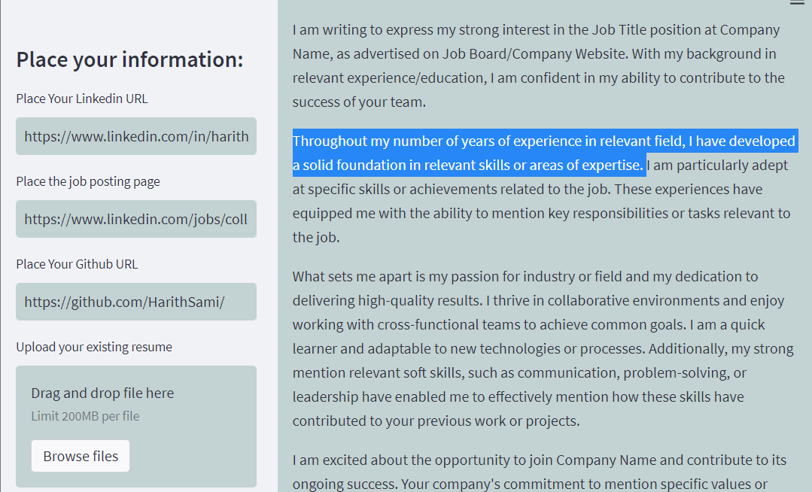
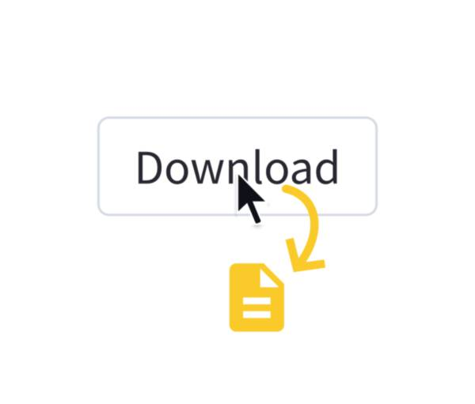
How to use:
1
Input LinkedIn and Job Posting Links.
Select Desired Resume Elements.
Select your preferred style
Preview and Edit.
Export and Share.
1
2
3
2
3
4
5
4
4

Slide 6
Prototype Demo
giksgsdkodpgsdsgkopdgskopdgskop
1
gddgsgdsdgsgds
1
2
Project can be found on this repository:
https://github.com/harith-alsafi/smartapply
2

Slide 7
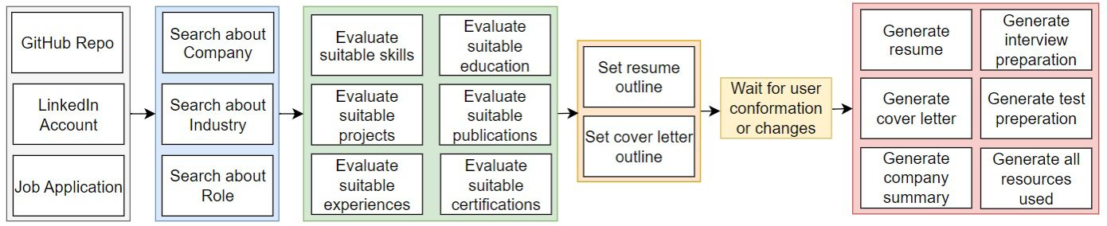

Basic Project Layout
1
The Accessibility Checker should pass without errors on accessible templates. To run the Accessibility Checker, go to File > Check for Issues > Check Accessibility.
2
Every slide needs a unique title. You can use the text "Add a Slide Title - 1“ if you don’t have a specific title, and then you can increase the number for every slide.
1
2
Learn more about using the Accessibility Checker
Learn more about using unique slide titles

Slide 8
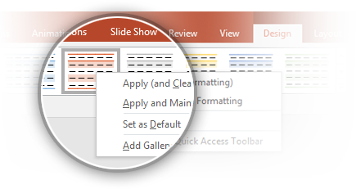

Current Demo Layout
First make sure there are no blank cells in your table. All table cells need to have content for screen readers to read.
Next run the color contrast analyzer tool on your table. You might need to change the design from the default colors to make them accessible.
Class | Group 1 | Group 2
Class 1 | 82 | 95
Class 2 | 76 | 88
Class 3 | 84 | 90
Tip: Tables should not have any alt text on either the title or description because it causes an error in screen readers. This will cause an error in the Accessibility checker which can be ignored.
If you change the table style, remember to set the new style as the default. To do this, select the table and go to Table Tools > Design > Table Styles, right click on the style you are using and select Set as Default.
Learn more about Accessibility best practices

Slide 9
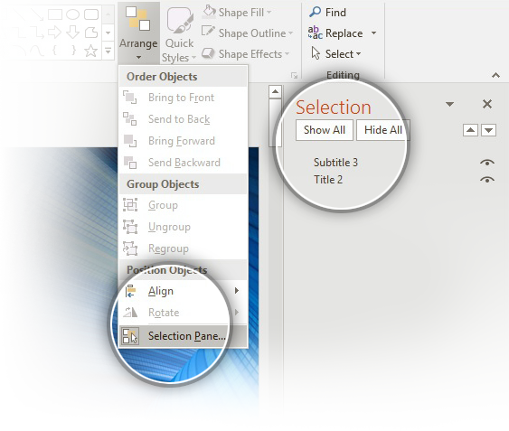
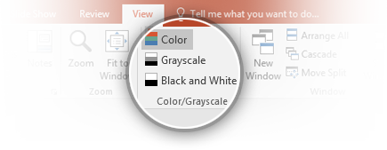
Process of Building our prototype
3
Whenever there is text in front of a color, there has to be enough contrast between the foreground and background. The guideline is a ratio of 4.5:1 for normal text and 3:1 for large text (>= 18 pt font size)
Tip: Not all graphic elements need to pass the Accessibility Checker tool; only graphics that appear behind text.
6
The reading order has to be correct for all slides, in both the Master and sample slides. To change the reading order, go to Home > Drawing > Arrange > Selection Pane.
Read more about setting the reading order of slide contents
6
4
Make sure templates are readable in Black and White, Grayscale, and Color views in both the Master and sample slides.
4
5
Screen readers often read file names out loud to users so your template needs to have an appropriate name for easy searching.
7
Font sizes need to be 11pts or larger for readability.

Slide 10
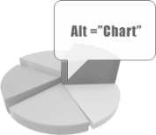
Scalability Features
All charts also need to have alt text. To add alt text to a chart, right click on the chart and select Format Chart Area which will open the Format Chart Area pane, then go to Size & Properties > Alt Text and enter your alt text only into the Description field.
Alt text examples for two different chart types on this slide:
1
Line chart showing values of three series for four categories
2
Clustered column chart showing values of three series for four categories
1
2
Learn more about adding alt text to charts

Slide 11
Business plan
All charts also need to have alt text. To add alt text to a chart, right click on the chart and select Format Chart Area which will open the Format Chart Area pane, then go to Size & Properties > Alt Text and enter your alt text only into the Description field.
Alt text examples for two different chart types on this slide:
1
Line chart showing values of three series for four categories
2
Clustered column chart showing values of three series for four categories
1
2
Learn more about adding alt text to charts

Slide 12

Learn More
More questions about Accessibility?
Visit the repository page here
→
github.com/harith-alsafi/smartapply

